Slide 1
Basic Sentence Structure: Simple, Compound and Complex Sentences

Slide 2
Sentence Types
Simple
Compound
Complex

Slide 3
Basic Elements of Every Sentence
SUBJECT
PREDICATE

Slide 4


Basic Elements
SUBJECT
PREDICATE
Alice
plays tennis.

Slide 5
Simple Sentence

Slide 6

Simple Sentence
A simple sentence has one subject and one predicate.

Slide 7
Simple Sentence
Observe how a simple sentence is constructed:
We went to Penang yesterday.

Slide 8
Simple Sentence
Pronoun
Verb
Prepositional phrase
We went to Penang .
Simple subject
Complete predicate

Slide 9
SIMPLE SENTENCE
SUBJECT
PREDICATE
Alice
plays tennis.
one subject one predicate

Slide 10

Simple Sentence
Jerry and Alice
play tennis.
Compound Subject
&

Slide 11

Simple Sentence
Jerry and Alice
play tennis and swim.
Compound Subject Compound Predicate
&
&

Slide 12
SIMPLE SENTENCE with compound subject
Jerry and Alice play tennis.

Slide 13
SIMPLE SENTENCE with compound subject and compound predicate
Jerry and Alice play tennis and swim.

Slide 14
Compound Sentence

Slide 15
Compound Sentence
A compound sentence has more than one part that can stand alone (independent clauses).
Independent clauses are connected by coordinating conjunctions, conjunctive adverbs or a semi-colon.
Coordinating conjunctions are easy to remember if you think of the words "FAN BOYS":
For And Nor But Or Yet So.

Slide 16

Compound Sentence
We went to Penang, and
most of us danced all night.

Slide 17
Compound Sentence
Subject
Verb
Prepositional phrase
We went to Penang,
Predicate
Coordinating
Conjunction
and most of us danced all night .
Subject
Verb
Modifying phrase

Slide 18
Compound Sentence Use of Coordinating Conjunctions
SUBJECT
PREDICATE
and
SUBJECT
PREDICATE

Slide 19
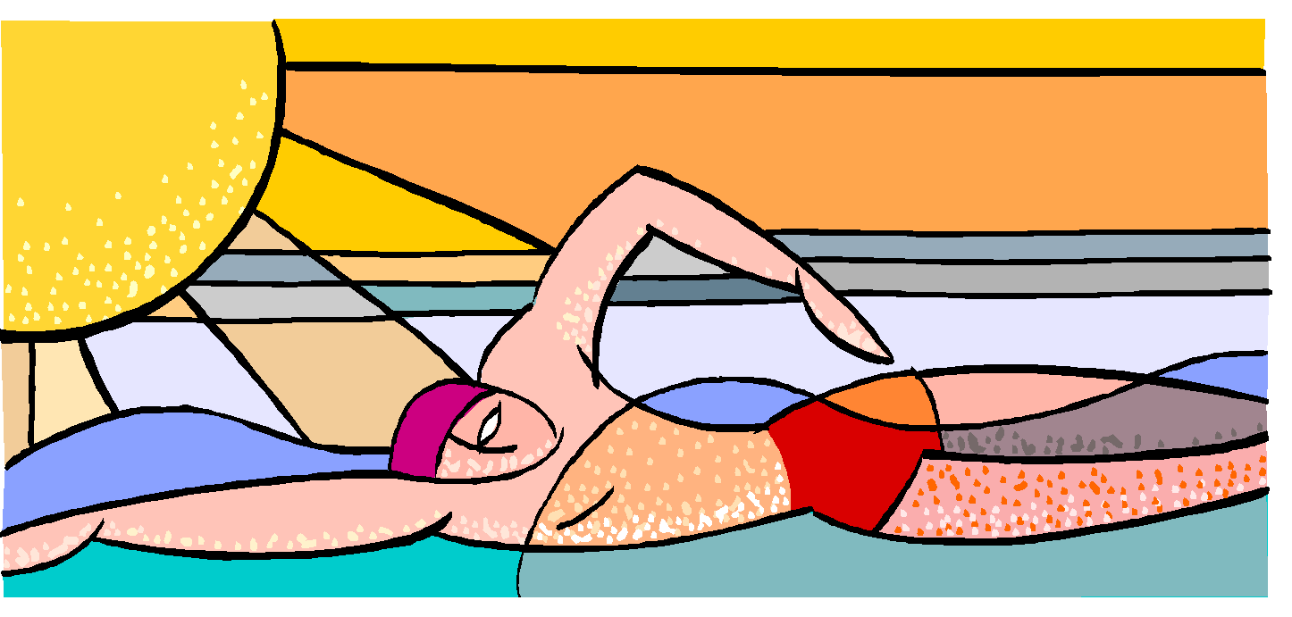
Compound Sentence
Tom
swims,
and
Mary
plays tennis.

Slide 20
COMPOUND SENTENCE: COORDINATING CONJUNCTIONS
FANBOYS
FOR
AND
NOR
BUT
OR
YET
SO

Slide 21
COMPOUND SENTENCE: COORDINATING CONJUNCTIONS
Tom swims, and Mary plays tennis.
Clause 1 Clause 2
Independent Independent

Slide 22
Compound Sentence
He was feeling sick, so he went to the doctor.
Use “so” to join two independent clauses
First sentence is the reason for the second clause

Slide 23
Compound Sentence
I like to eat candy, but I don’t like to eat popcorn.
-Two independent clauses
-“I like to eat candy”
-“I don’t like to eat popcorn”
-could both form complete sentences.
The example has now become a compound sentence, i.e. one that contains two independent clauses joined by a coordinating conjunction (but).
Independent Clause + Independent Clause

Slide 24
Complex Sentence

Slide 25
Complex Sentence
A complex sentence has at least two parts: one that can stand alone and another one that cannot
The part that cannot stand alone is linked to the rest of the sentence by a subordinating conjunction.
DEPENDENT-CANNOT STAND ALONE
INDEPENDENT-CAN STAND ALONE

Slide 26

Complex Sentence
Since my friends and I wanted to have fun,
we went to Penang yesterday.

Slide 27
Complex Sentence
Since we wanted to have fun,
Subordinating
Conjunction
Part that cannot stand alone
Subject
Predicate
we went to San Juan yesterday.

Slide 28
Complex Sentence
SUBJECT
PREDICATE
even though
SUBJECT
PREDICATE

Slide 29
COMPLEX SENTENCE: SUBORDINATING CONJUNCTIONS
The most common subordinating conjunctions are "after," "although," "as," "because," "before," "how," "if," "once," "since," "than," "that," though," "till," "until," "when," "where," "whether,” and while."

Slide 30
COMPLEX SENTENCE: SUBORDINATING CONJUNCTIONS
Bob is popular even though he is shy.
Clause 1 Clause 2
Independent Dependent

Slide 31
COMPLEX SENTENCE: SUBORDINATING CONJUNCTIONS
Even though Bob is ugly, he is popular.
Clause 1 Clause 2
Dependent Independent
Adapted from: https://www.slideshare.net

Slide 32
Complex Sentence
Even though he suffered from arthritis, he studied hard because he wanted to go to medical school.
Notice how the subordinating conjunction adds additional meaning to the sentence.
A subordinate clause can go at the start, in the middle or at the end of a sentence.

Slide 33
Complex Sentence
When it comes in the middle of a sentence, it is marked off by a comma on either side.
For example:
Jack waved to the boat, while he was eating an ice-cream.
While he was eating an ice-cream, Jack waved to the boat.
Jack, while he was eating an ice-cream, waved to the boat.

Slide 34
Complex Sentence
Complex sentences can also be constructed by using relative pronouns such as that, which, who, whose, where, when.
For example:
Tom, who liked to read, settled down happily with his new book.
In 2003 Sarah moved to Boston, where her grandparents lived.

Slide 35
Complex Sentence
I don’t like to eat candy because it is too sweet.
However, there is an important distinction to be made when a subordinating conjunction is added to a clause.
These words – such as since, whenever, although, because – act to make a clause a dependent clause, even if it looks like an independent clause.
I don’t like to eat candy (independent clause – makes sense on its own).
Because it is too sweet. (dependent clause – does not make sense on its own without more information).

Slide 36
Complex sentence
Dependent Clause + Independent Clause (comma splits the clause)
Independent Clause + Dependent Clause (comma usually does not split the clause)
So, using that structure we can easily form examples of complex sentences:
EXAMPLES:
Because she was scoring many goals, Elsa was considered the best player on the team.
Elsa was considered the best player on the team because she was scoring many goals.
Since Hannah got here, she’s been nothing but trouble.
Hannah has been nothing but trouble since she got here.

Slide 37
Complex Sentence
You should also be aware that a complex sentence can contain more than one dependent clause. Here are some examples of those types of complex sentences:
Because I was often late, and since I was always forgetting things, I was regarded as a scatterbrain by my friends.
Although the war ended, and as people tend to have short memories, the city’s people were still divided over its impact.

Slide 38
Exercises
Say if the following sentences are:
Simple, compound, or complex .

Slide 39
The bell rang.
Bridget ran the first part of the race, and Tara biked the second part.
He stands at the bottom of the cliff while the climber moves up the rock.
The lady turned and jumped.

Slide 40
Answers
Simple
Compound
Complex
Simple

Slide 41
Because Kayla has so much climbing experience , we asked her to lead our group.
You and I need piano lessons.
I planned to go to the hockey game, but I couldn’t get tickets.
Dorothy likes white water rafting, but she also enjoys kayaking.

Slide 42
Answers
Complex
Simple
Compound
Compound

